Slide 1
Front End Engineering-I Project
Team Details: Three members:
1 .Shreya Sharma(2310992528)
2.Shivek Mittal (2310992527)
3.Shubham(2310992529)
Faculty Coordinator: Dr. Ratan Deep Aneja
:
Chitkara University Institute of Engineering and Technology,
Chitkara University, Punjab

Slide 2
Table of Contents
Introduction
Problem Statement
Technical Details
Key Features
Project Highlights
Bonus Feature
Conclusion
References/Links used

Slide 3
Introduction
Welcome to our Music Player Project Presentation
The aim of this project is to create a fully functional music player using HTML and CSS.
Title - Music Player
Music Player’s Name – 3S
Purpose - Easily accessible music player
Music Player’s Logo - 3S

Slide 4
Problem Statement
Since today no one can live without music. Just like food , oxygen , and money music has become a great part of our life . So keeping that in mind we the 3s has created a music player.
Our goal was to create a fully functional music player using HTML and CSS and JAVASCRIPT.
So that a person can enjoy music anytime anywhere

Slide 5
Technical Details
HTML: Our HTML structure forms the foundation of the player, with <audio> elements for audio playback and <div> for layout.
CSS: Carefully crafted CSS styles dictate the player's appearance, including fonts, colours, and layout.
JAVASCRIPT: the overall functionality of our website is based on javascript. Just like backbone of a human javascript is the backbone of a static website
Python: used python for login authentication and maintaining databse for new sign ups

Slide 6
Key Features
Play, Pause, and Stop Buttons: These buttons allow users to control playback.
Volume Control: Users can adjust the volume with an intuitive slider.
Progress Bar: This visual indicator displays the current song's progress and allows users to skip to specific parts.
Song Information Display: All relevant song details, such as title, artist are prominently displayed.
Users can listen to songs ad free.

Slide 7
Project Highlights
Innovative UI Elements: Our player includes visually appealing buttons and controls that enhance the user experience.
Simplicity and User-Friendliness: The player is designed to be intuitive, allowing users to enjoy music hassle-free.

Slide 8
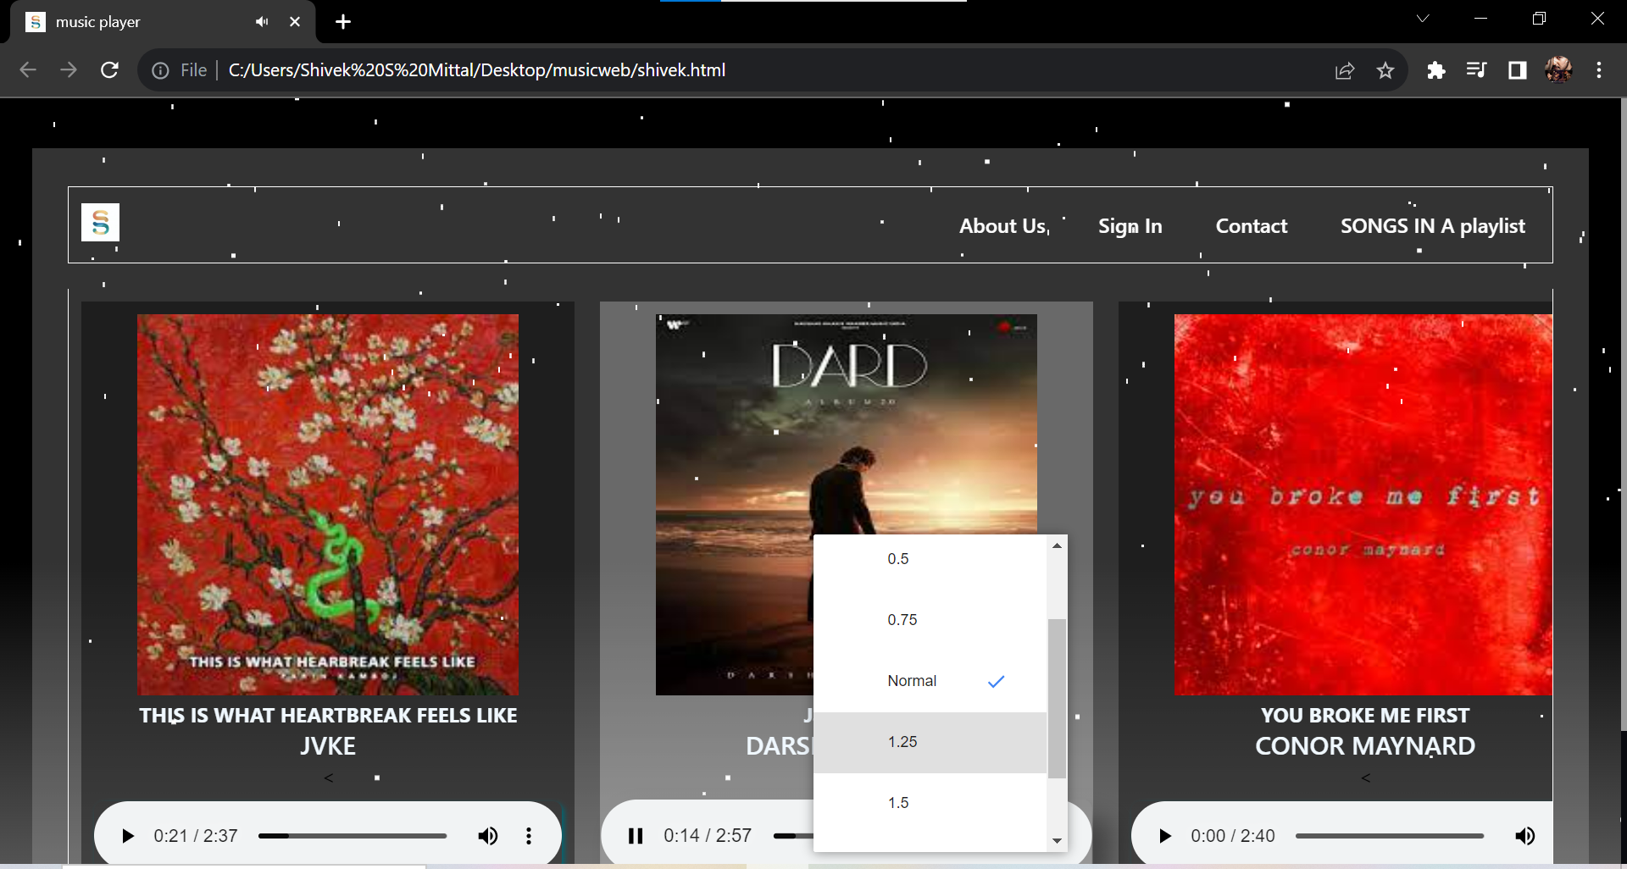
Bonus Feature(optional)
Playback Speed : Users can set speed of song of their choice.

Slide 9
Conclusion
In conclusion, this project has been a valuable learning experience.
We've overcome challenges and achieved success in creating a feature-rich music player.
Looking ahead, we plan to further enhance the player and explore new possibilities in web development.

Slide 10
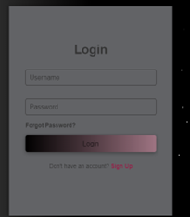

RESULT
LOGIN PAGE :

Slide 11
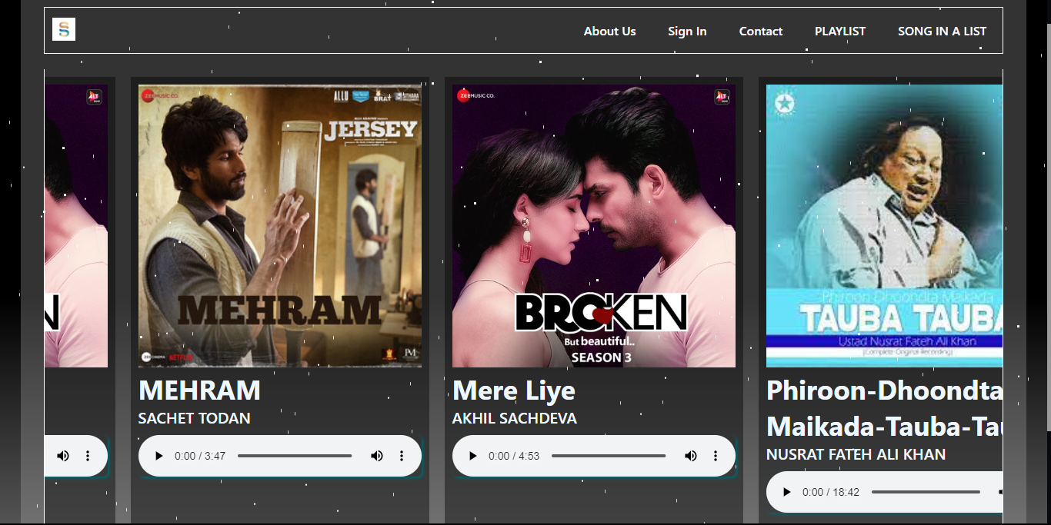
MUSIC PLAYER

Slide 12
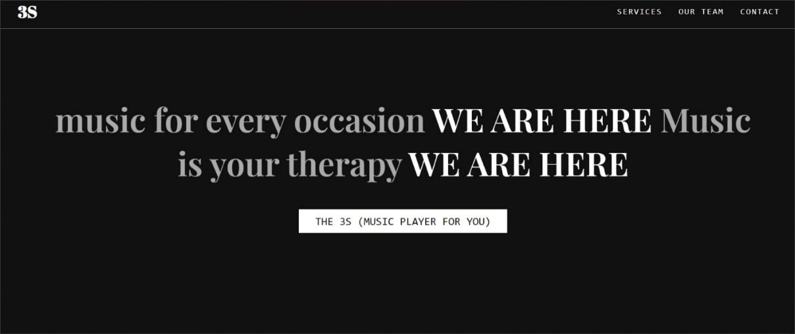
ABOUT US PAGE

Slide 13
References/Links used
https://www.w3schools.com/tags/tag_audio.asp

Slide 14


